Slide 1
AMDM
Golf Balls and Airplanes

Slide 2
The Question
How many golf balls can fit into a Boeing 747 commercial airplane?

Slide 3
The Golf Ball
The formula for volume of a sphere is

Slide 4
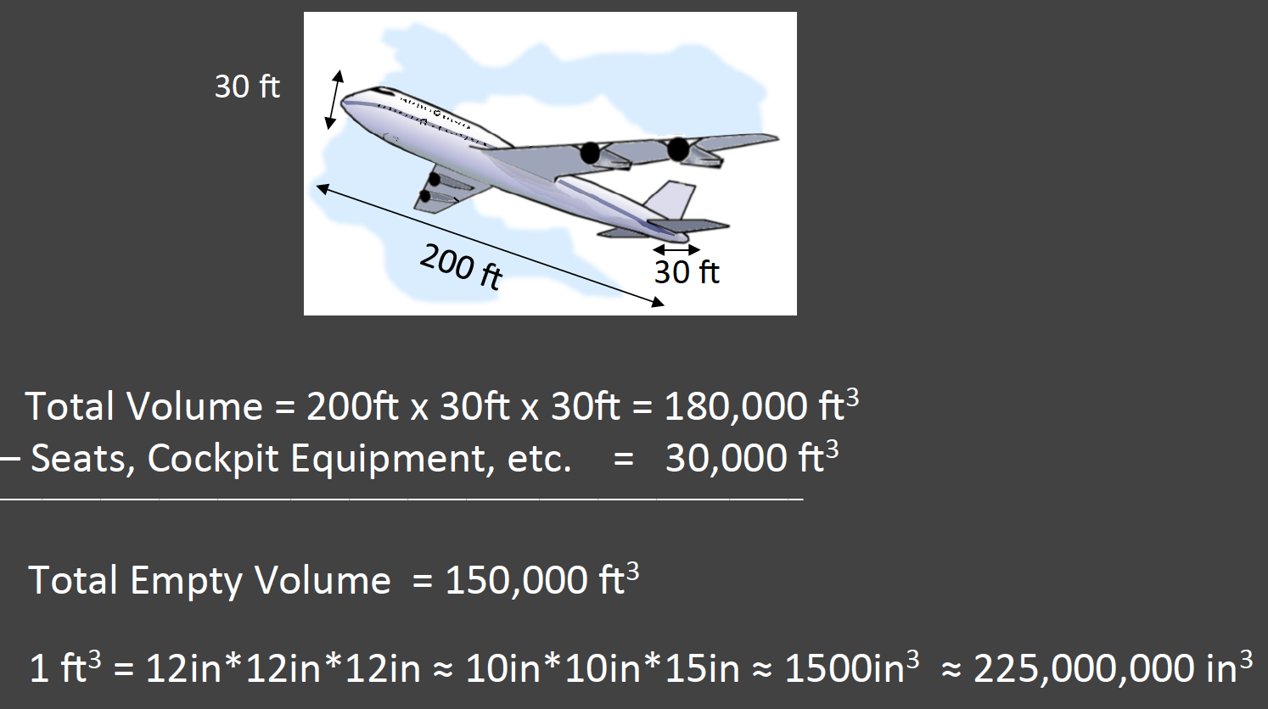
The Airplane

Slide 5
The Answer

Slide 6
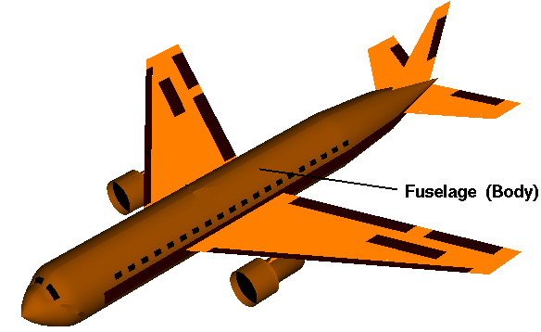
Extension
The fuselage of an aircraft is the main body section that holds the crew, passengers and cargo.
Based on calculations for the airplane, the volume was calculated as if the fuselage was a rectangular shape. How could you improve your estimate if you calculated the volume of the fuselage as a cylinder and a cone. Use this link from NASA to help you determine a more efficient method for calculating volume.

